Slide 1

Asynchronous Programming
Ali Ghanbari
Aligator

Slide 2
Overview
Asynchrony
Programming models
Control flow models
Async I/O syntax

Slide 3
Asynchrony

Slide 4
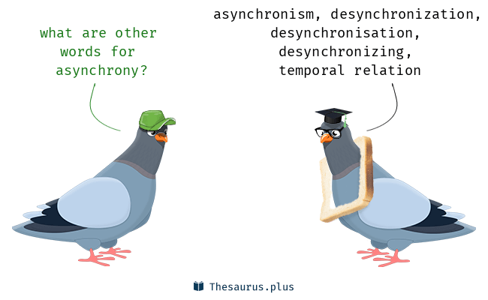
Asynchrony
Definition
“Asynchrony, in computer programming, refers to the occurrence of events independent of the main program flow and ways to deal with such events.”
Meaning
The relation that exists when things occur at unrelated times.

Slide 5
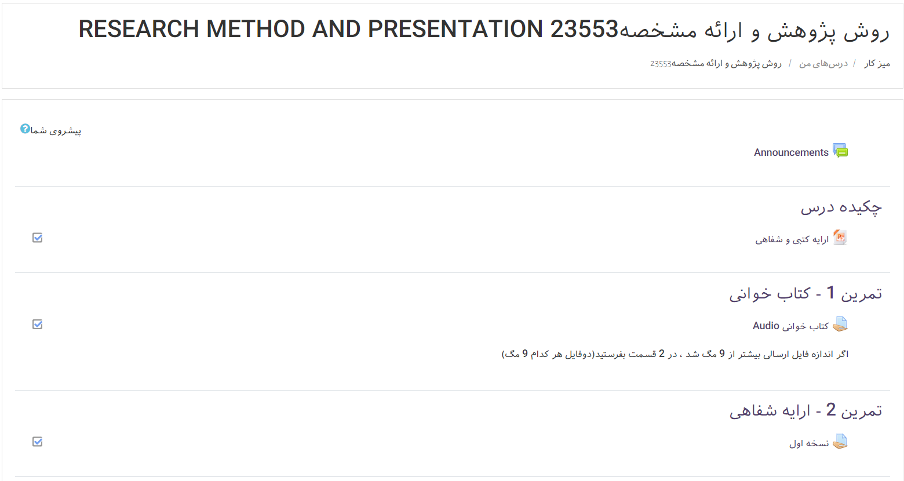
Education Example
Synchronous Online learning
Adobe connect
Chat rooms
Asynchronous Online learning
Slides
Videos
Message boards
Moodle LMS – an asynchronous learning platform

Slide 6

Uses
AJAX
HTTP/2
Web Sockets
Online Games
Collaborative Environment
Realtime Chat
slither.io – online browser game

Slide 7

Front End Frameworks
React
Vue
Angular
Flutter
Svelte

Slide 8
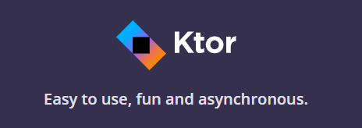
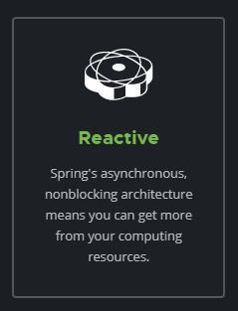
Web Frameworks
Ktor
Spring Boot
Express.js
Go
ASP.NET Core
Django 3.0

Slide 9

Reactive Extensions(RX)
“Reactive programming is programming with asynchronous data streams.”

Slide 10
“Often the programmer is fully aware that what they are doing is object oriented but only vaguely aware that they are writing asynchronous code.”
Mike James
Editor at iProgrammer

Slide 11
Programming models

Slide 12
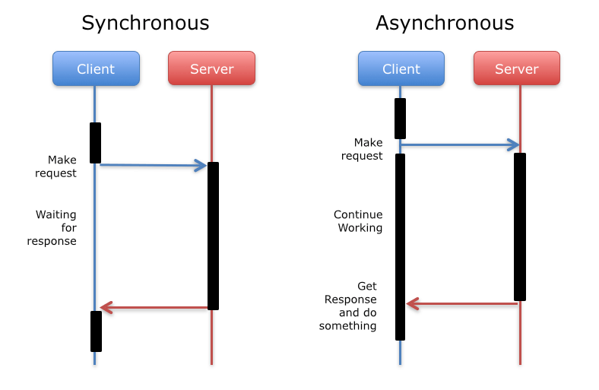
Programming Models
Synchronous
Runs code sequentially
Blocks the main thread on I/O request
Asynchronous
Doesn’t block the main thread on I/O request
Unpredictable Behavior

Slide 13
Scenarios for Async
I/O operations
Performing multiple operations parallelly
Long-running event-driven requests
Cooperative multitasking

Slide 14

Restaurant Example
Synchronous restaurant
Takes one order
Waits until it is ready
Asynchronous restaurant
Takes all orders
Brings the order that is ready

Slide 15
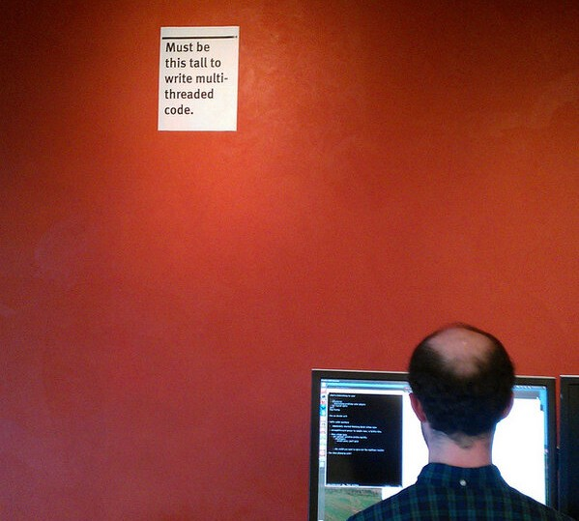
Benefits
More Responsive Applications
No need to write multi-threaded code for I/O operations
Lower system resource usage

Slide 16

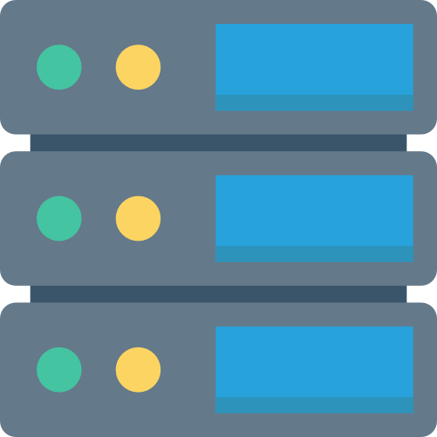

Async in Servers
Synchronous Servers cost per user
Native Thread
Native Memory (thread stack: 1 MiB per thread)
OS scheduler data structures
Local variables in the stack frames
GC needs to walk the stack frames
Asynchronous Servers cost per user
Memory

Slide 17
History
Thread
I/O Thread
Thread Pools
Asynchronous Programming

Slide 18
Async Control Flow Model

Slide 19
Async Control models
Async control flow models
Async I/O
Futures
async/await
coroutines

Slide 20
Coroutines
Behave like Threads
Lightweight
val jobs = List(100_000) {
launch {
delay(1000)
print(".")
}
}
Kotlin

Slide 21
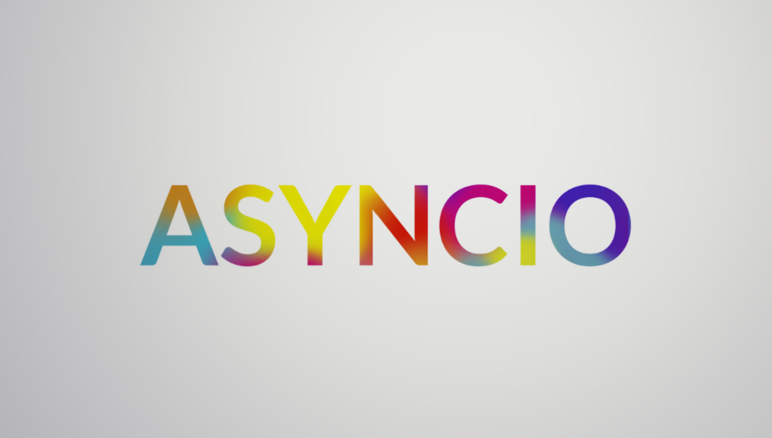
Asynchronous I/O
I/O Thread
Event Loop

Slide 22
I/O Thread
Main Thread
Event Loop
IO Thread
The Main Thread uses a dedicated IO Thread to not get blocked

Slide 23
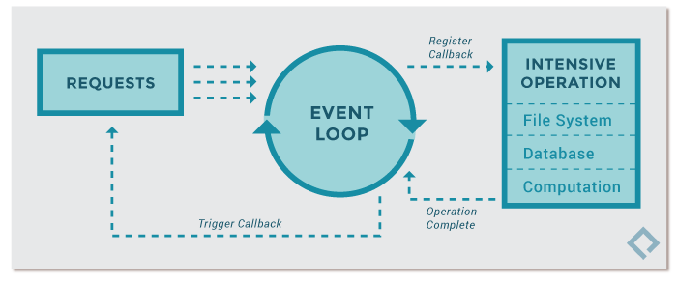
Event Loop
It’s a loop
With an Event Queue
Starts running when the thread goes to idle

Slide 24
Async I/O code

Slide 25
Example
Synchronous
Asynchronous
void main() { var file = File("../text.txt");
print("1");
printContentSync(file);
print("2"); }
void main() { var file = File("../text.txt"); print("1"); printContentAsync(file); print("2"); }
1
Hello World!
2
1
2
Hello World!

Slide 26
Asynchronous I/O Syntax
Callbacks (Future/Promise/Task/Single)
async/await

Slide 27
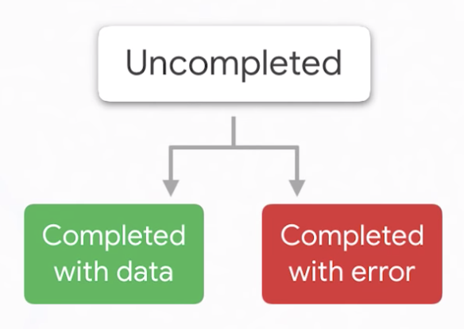
Future
Uncompleted
Completed with data
Completed with error
The 3 States of a future

Slide 28
Future Example
void printWebPage(String url) { http.get(url).then((response) { print(response.body); }); }

Slide 29
Future Example
void printWebPage(String url) { http.get(url).then((response) { print(response.body); }); }
async function

Slide 30
Future Example
void printWebPage(String url) { http.get(url).then((response) { print(response.body); }); }
Completion callback

Slide 31
Future Callbacks
void printWebPage(String url) {
http.get(url).then((response) {
print(response.body);
}).catchError((error) {
print('error: $error’);
}).timeout(Duration(seconds: 10)); }

Slide 32
Nested Callbacks
void saveWebPage(String url) { http.get(url).then((response) { File('../webpage.html').create().then((file) { file.writeAsString(response.body).then((file) { print('webpage saved.'); }); }); }); }

Slide 33
Nested Callbacks
void saveWebPage(String url) { http.get(url).then((response) { File('../webpage.html').create().then((file) { file.writeAsString(response.body).then((file) { print('webpage saved.'); }); }); }); }
A lot of parenthesis

Slide 34
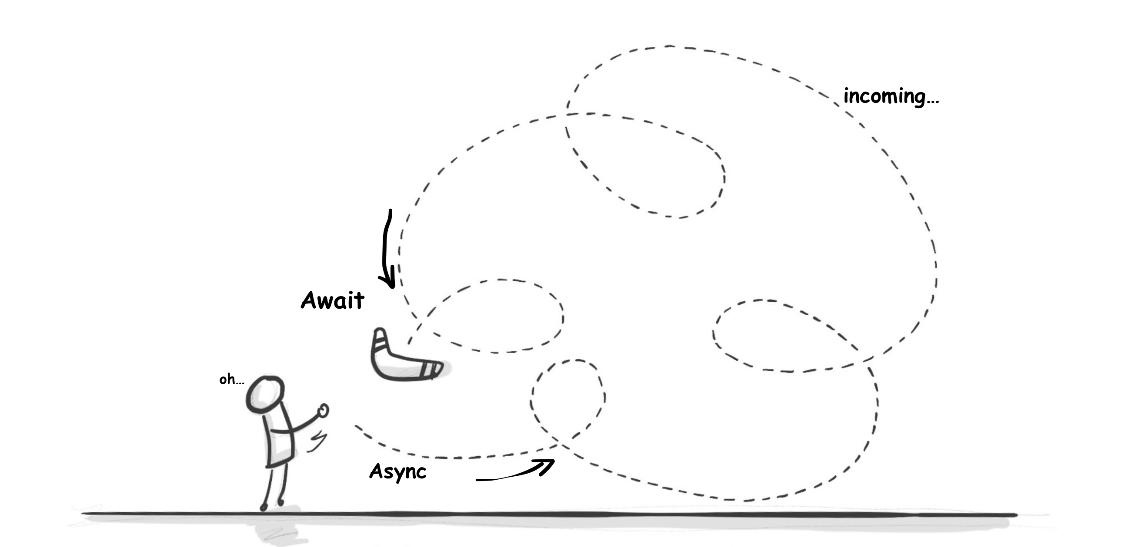
The async/await Syntax
Supported in C#, JavaScript, Dart, Python, ….
Similar to synchronous code.
Easy to read
Easy to learn
Easy to debug

Slide 35
Syntax Comparison
Future Syntax
async/await syntax
void saveWebPage(String url) { http.get(url).then((response) { File('../webpage.html').create() .then((file) { file.writeAsString(response.body) .then((file) { print('webpage saved.'); }); }); }); }
void saveWebPage(String url) async{ var response = await http.get(url); var file = File('../webpage.html'); await file.create(); await file.writeAsString(response.body); print('webpage saved.'); }

Slide 36
References
https://web.archive.org/web/20170704074724/https://webdev.dartlang.org/articles/performance/event-loop
https://www.i-programmer.info/programming/theory/6040-what-is-asynchronous-programming.html
https://softwareengineering.stackexchange.com/questions/187492/why-do-we-need-the-async-keyword
https://developer.mozilla.org/en-US/docs/Learn/JavaScript/Asynchronous/Concepts
https://stackify.com/when-to-use-asynchronous-programming/
https://hackernoon.com/asynchronous-programming-101-5ac0fa4e84e8
https://www.codeproject.com/Tips/866962/Async-and-Await-Tutorial
https://en.wikipedia.org/wiki/Asynchrony_(computer_programming)
https://thebestschools.org/magazine/synchronous-vs-asynchronous-education/
https://kotlinlang.org/docs/reference/coroutines/basics.html
https://www.xenonstack.com/insights/coroutines/
https://medium.com/dartlang/dart-asynchronous-programming-futures-96937f831137
https://thesaurus.plus/related/asynchrony/desynchronizing
https://www.tutorialspoint.com/operating_system/os_io_hardware.htm
https://www.codementor.io/@robbritton/the-story-of-asynchronous-programming-hhcwtd1vx

